Slide 1
MALL CUSTOMER SEGMENTATION

Slide 2

MALL CUSTOMER SEGMENTATION
INSTITUTE OF TECHNOLOGY & SCIENCE MOHAN NAGAR, GHAZIABAD Batch: 2021-2024
Group by:
Rudraksh Kaushik (210934106262)
Anshika Jain (210934106060)
Aditya Pandey (210934106027)

Slide 3
CONTENT
Introduction
Dataset
Tool Used
Methodology
Hardware Requirements
Software Requirements
Product Perspective
Why Use Customer Segmentation ?
Conclusion
Code & Reuslts

Slide 4
INTRODUCTION
Problem Statement: Understanding customer behavior and preferences by segmenting customers into distinct groups based on their demographic and purchasing patterns.
Purpose: To identify key customer groups that present the greatest potential for driving sales growth.
Scope: Data collection, preprocessing, segmentation analysis, and generating actionable insights.

Slide 5
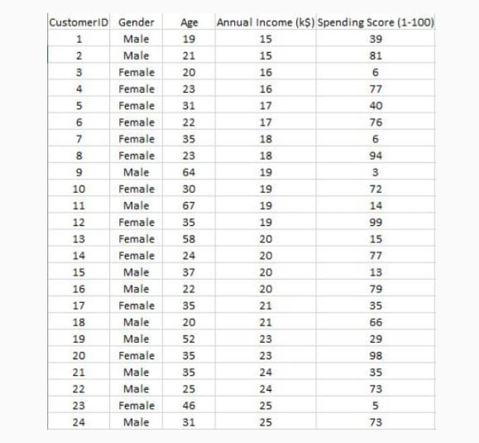
DATASET
The dataset name is Mall customer.csv consisting five attributes which are gender, customer I'd, age , annual income and spending score .
The maximum size of data set is (200,5) i.e. 200 rows and 5 columns

Slide 6
TOOLS USED
Python: A dynamic, interpreted language used for scripting and implementing the entire project.
Jupyter Notebook: An interactive development environment for writing and running Python code.
Pandas: A powerful library for data manipulation and analysis.
NumPy: A library for numerical computing in Python.
Scikit-learn: A machine learning library that provides simple and efficient tools for data mining and data analysis.
Matplotlib: A plotting library for creating static, interactive, and animated visualizations in Python.
Seaborn: A Python visualization library based on Matplotlib that provides a high-level interface for drawing attractive and informative statistical graphics.
Plotly: A graphing library that makes interactive, publication-quality graphs online.

Slide 7
METHODOLGY
Data Collection: Collecting customer data from various sources.
Data Exploration and Preprocessing: Cleaning and transforming the data for analysis.
Exploratory Data Analysis (EDA): Analyzing the data to gain insights.
Feature Engineering: Creating new features or transforming existing ones.
Clustering: Applying clustering algorithms to segment customers.
Evaluation: Evaluating the performance of the clustering algorithms.

Slide 8
HARDWARE REQUIREMENTS
RAM: 8 GB or higher
Storage: 256 GB SSD or higher
SOFTWARE REQUIREMENTS
Operating System: Windows
Python: 3.8 or higher
IDE: Jupyter Notebook, VS Code
Libraries: Pandas, NumPy, Matplotlib, Seaborn, Plotly, Scikit-learn

Slide 9
PRODUCT PERSPECTIVE
Input: Customer demographic data and purchasing behavior data.
Processing: Data preprocessing, clustering, and visualization.
Output: Identified customer segments with distinct characteristics, visualizations of customer segments, and insights and recommendations for targeted marketing strategies.
Benefits: Improved understanding of customer demographics and behaviors, ability to design targeted marketing campaigns and personalized offers, enhanced customer experience and satisfaction.
Deployment: The final product, including the code, visualizations, and reports, can be deployed on a local machine or a cloud-based environment for easy access and sharing with stakeholders.
Scalability: The methodology and code can be easily scaled to handle larger datasets and more complex clustering scenarios as the mall expands and collects more customer data.

Slide 10
Why Use Customer Segmentation?
More time: Manual customer segmentation is time-consuming.
Ease of retraining: More labeled data becomes available after development, and it’s a great resource for improving the overall performance of the model.
Better scaling: Machine learning models have the inherent capability to handle more data and scale in production.
Higher accuracy: The value of an optimal number of clusters for given customer data is easy to find using machine learning methods like the elbow method.

Slide 11
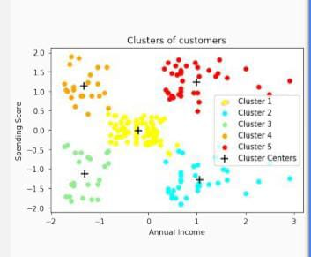
Conclusion
High Income, High Spending Score (Cluster 5) - Target these customers by sending new product alerts which would lead to an increase in the revenue collected by the mall as they are loyal customers.
High Income, Low Spending Score (Cluster 2) - Target these customers by asking the feedback and advertising the product in a better way to convert them into Cluster 5 customers.
Average Income, Average Spending Score (Cluster 1) - May or may not target these groups of customers based on the policy of the mall.
Low Income, High Spending Score (Cluster 4) - Can target these set of customers by providing them with Low-cost EMI's, etc.
Low Income, Low Spending Score (Cluster 3) - Don't target these customers since they have less income and need to save money.

Slide 12
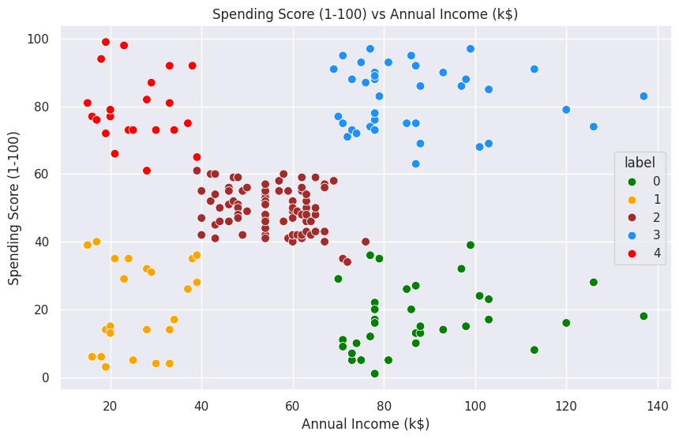
CODE & RESULTS
Dataset: Mall_Customers.csv
Data Visualization: Distribution of Annual Income, Age, and Spending Score.
Clustering Results: Annual Income Vs Spending Score after Clustering.

Slide 13
Advantages of Customer Segmentation
Budgeting: Targeting customers with the highest potential value first.
Product Design: Understanding what customers need.
Promotion: Planning special offers and deals.
Marketing: Tailoring marketing campaigns to different customer segments.
Customer Satisfaction: By studying different customer groups, learning what they value most
about the company, and creating personalized products and services that perfectly fit their perfernces.

